Slide 1

105 Unsupervised Learning - Clustering
Sunil Gorantla

Slide 2
What is Unsupervised learning ?
Definition
A type of machine learning algorithm used to draw inference from datasets consisting of input data without labelled responses.
The most common unsupervised learning methods is clustering analysis.
How It works
Algorithms are used to identify pattern in data.
The model tries to learn structure of the data without any supervision.
Applications:
Market basket analysis, anomaly detection, customer segmentation, etc…
Drawbacks
Complex and computationally intensive.
Harder to evaluate

Slide 3
Unsupervised Learning
Clustering Algorithms
K-Means
Hierarchical Clustering
Association Algorithms
Apriori
DBSCAN
Eclat
Dimensionality Reduction
PCA
t-SNE

Slide 4
Clustering Analysis
Unsupervised learning that groups a set of objects un such a way that the objects in the same group are more similar to each other then to those in other groups.

Slide 5
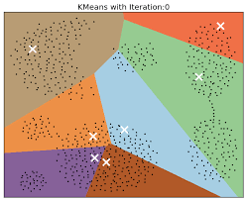
K-Means
Algorithm Steps
Choose the number of clusters (k)
Select k random points as cluster centers.
Assign each object to the cluster with the nearest center.
Recompute the cluster centers.
Repeat the steps and center change until no further changes can be made

Slide 6










Slide 7


K = 2
Pick 2 points

Slide 8




Slide 9
Gaming Company (10 Million Players)
Age
Location --> (building, street, state, pincode) States 29 groups, south , north, east and west
Education →
Financial
No of hour you play
No of hour game you play
Amount you spend the platform

Slide 10
Age | BMI | Gender
25 | 24 | 1
41 | 19 | 1
43 | 25 | 0
22 | 31 | 0
28 | 22 | 0
31 | 30 | 1
52 | 26 | 1
41 | 26 | 0

Slide 11
Hierarchical clustering
Hierarchical clustering is a method of clustering analysis which seeks to build a hierarchy of clusters.
Methods
Agglomerative
Divisive

Slide 12
Agglomerative (bottom-up Approach)
Algorithm Steps
Begin with n clusters, one for each data point.
Compute the proximity matrix.
Merge the closest pair of clusters
Update the proximity matrix
Repeat until only a single cluster remains
Parameters
Distance matric: Euclidean, Manhattan
Linkage Criterion: Distance between two sets of observation (single, complete, average, ward’s methods)

Slide 13







Slide 15
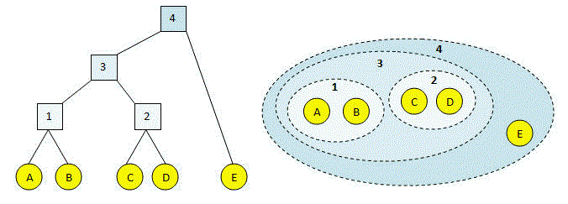


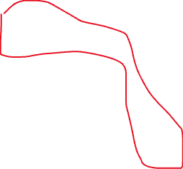


Slide 16



Slide 17
Divisive (Top-down Approach)
Algorithm Steps:
Begin with one clusters that includes all data points.
Determine the best point to split the cluster into two using a flat clustering method like k-means.
Repeat the process for each new cluster until each data point is a cluster.

Slide 18
DBSCAN (Density-based spatial clustering of applications with noise)
Algorithm Parameters
eps : the maximum distance between two points for them to be considered as in the same neighborhood.
MinPts: The minimum number of points required to form a dense region.
Algorithm Steps
Classify points as core, border, or noise, form cluster based on core points and reachability

